Slide 1

BACHELOR OF SCIENCE IN MATHEMATICS
DEPARTMENT OF MATHEMATICS
GOVERNMENT ARTS AND SCIENCE COLLEGE
THENNAGUR-604408
OCTOBER 2023

Slide 2

UNLOCKING INSIGHTS INTO THE GLOBAL AIR TRANSPORTATION NETWORK WITH TABLEAU
TEAM LEADER :
H.PUGAZHENTHI
TEAM MEMBERS :
M.GIRIJA
P.SANJAY
P.SANMUGAPRIYA
OUR MENTOR :
MR.R.SUDHAKAR
DEPARTMENT OF MATHEMATICS

Slide 3
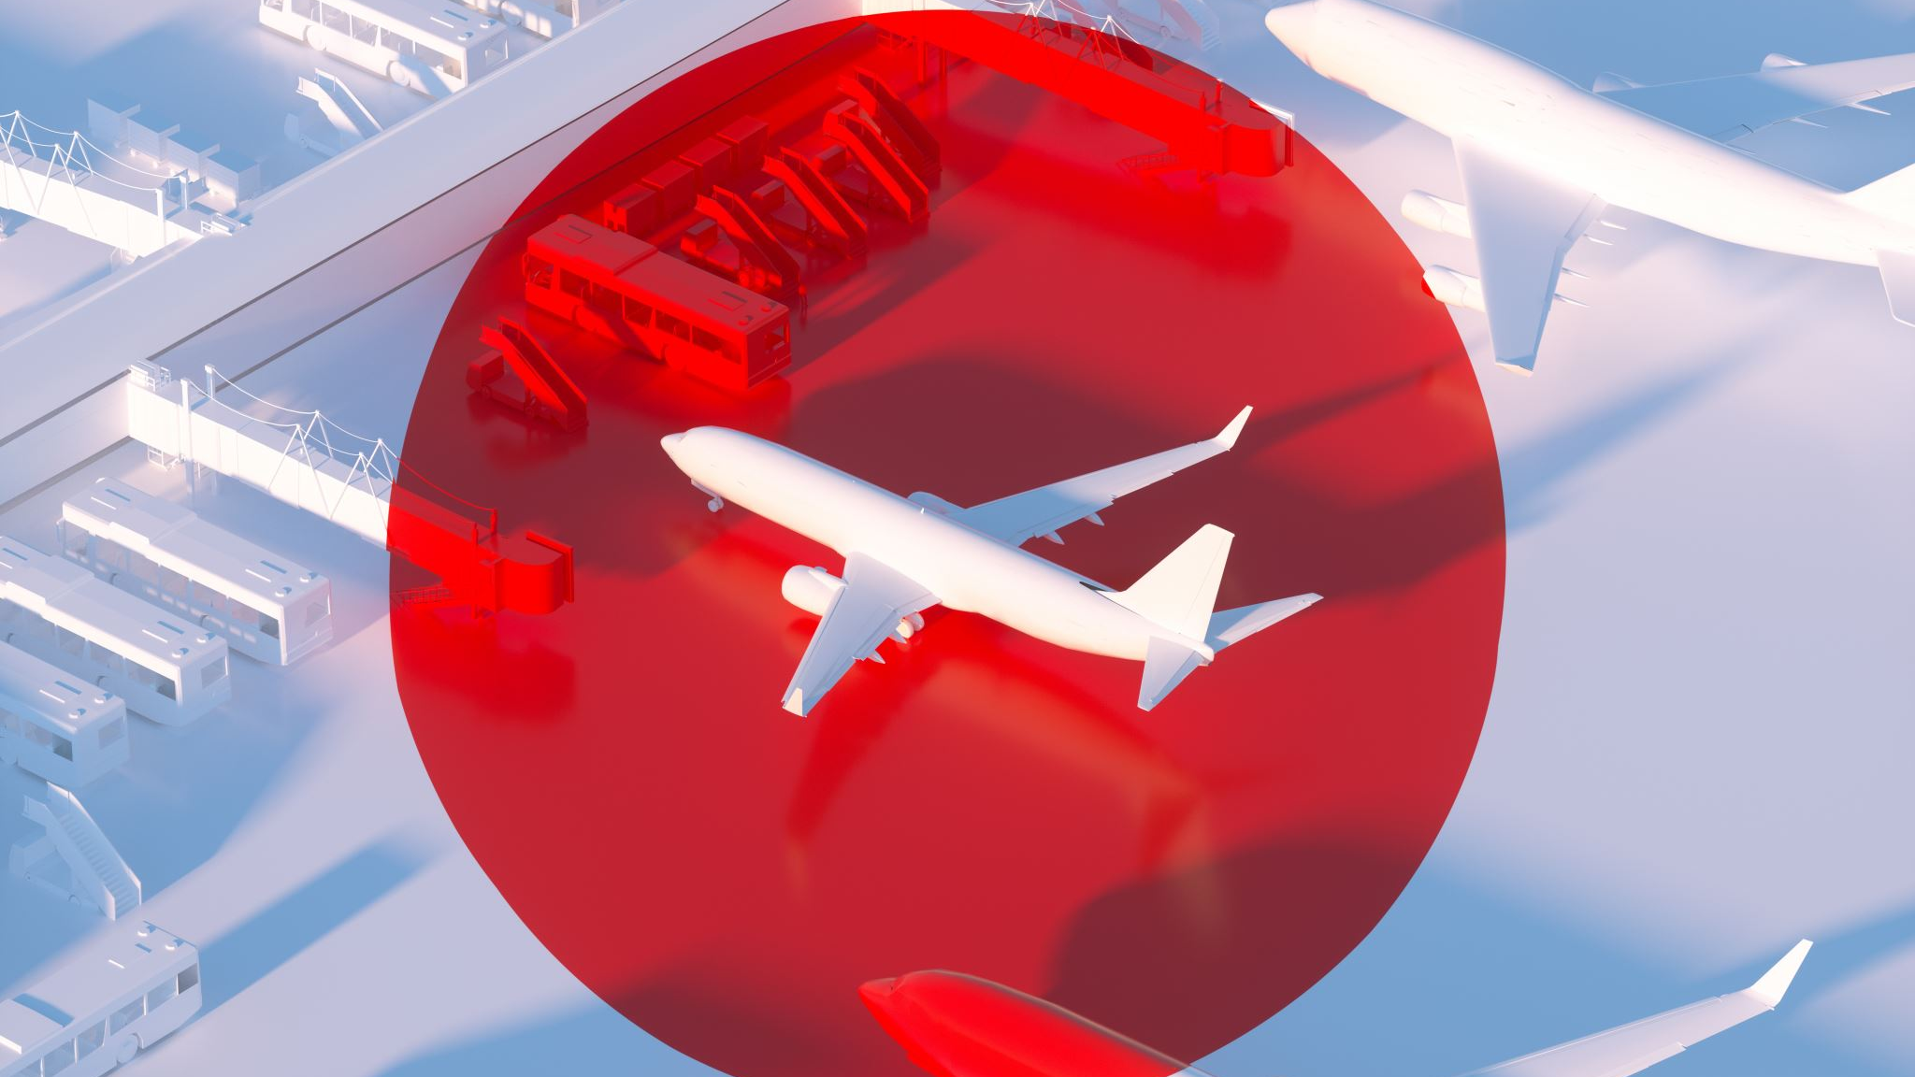
UNLOCKING INSIGHTS INTO THE GLOBAL AIR TRANSPORTATION NETWORK WITH TABLEAU

Slide 4

INTRODUCTION :
Unlocking insights into the global air transportation network with Tableau is a data-driven initiative that leverages the power of Tableau's data visualization and analytics tools to gain a deeper understanding of the complexities and opportunities within the aviation industry. This approach enables stakeholders to make informed decisions, enhance efficiency, and improve passenger experiences in the global air travel ecosystem.

Slide 5

OVERVIEW :
"Unlocking insights into the global air transportation network with Tableau involves using Tableau's powerful data visualization and analytics tools to analyze and understand the complexities of the aviation industry. This initiative enables data-driven decisions, operational improvements, and predictive insights for a more efficient and responsive air transportation network."

Slide 6

PURPOSE :
The purpose is to enhance the efficiency, safety, and decision-making within the global air transportation network by leveraging Tableau's data visualization and analytics for in-depth insights.

Slide 7
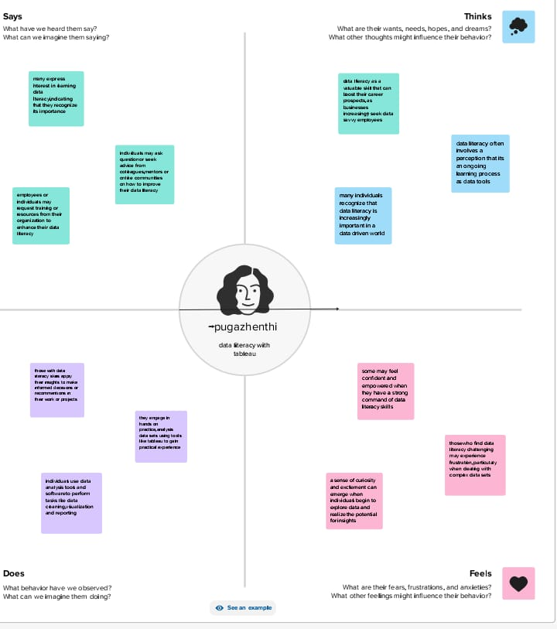

Slide 8
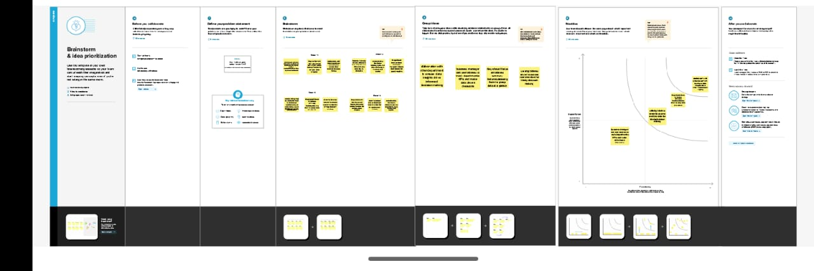

Slide 9
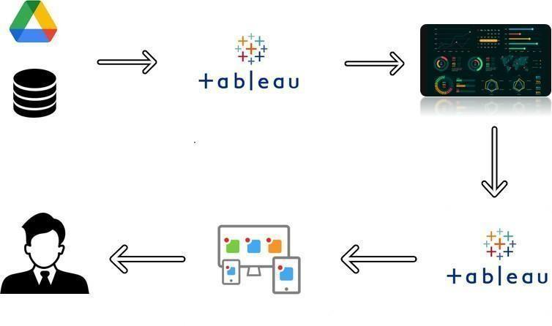

Slide 10
VISUALISATIONS :

Slide 11
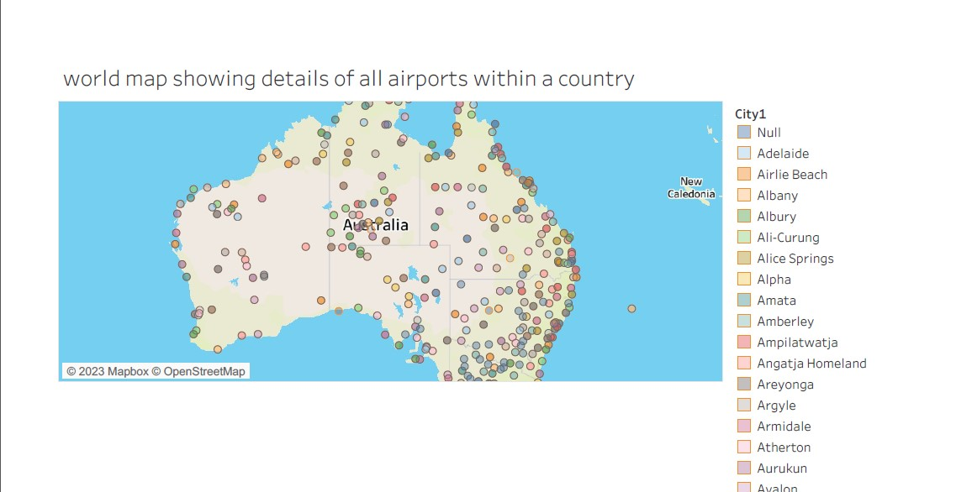

Slide 12
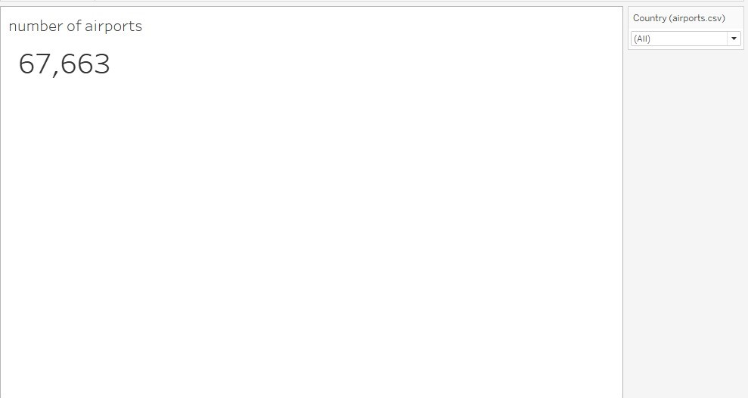

Slide 13
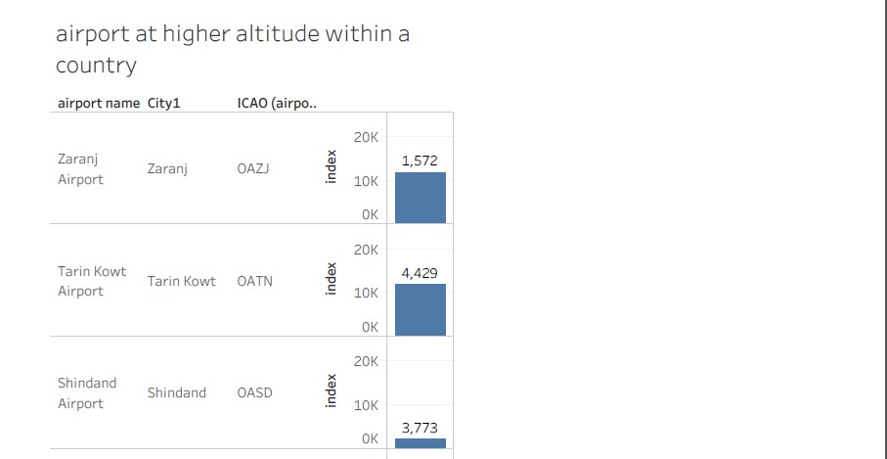

Slide 14
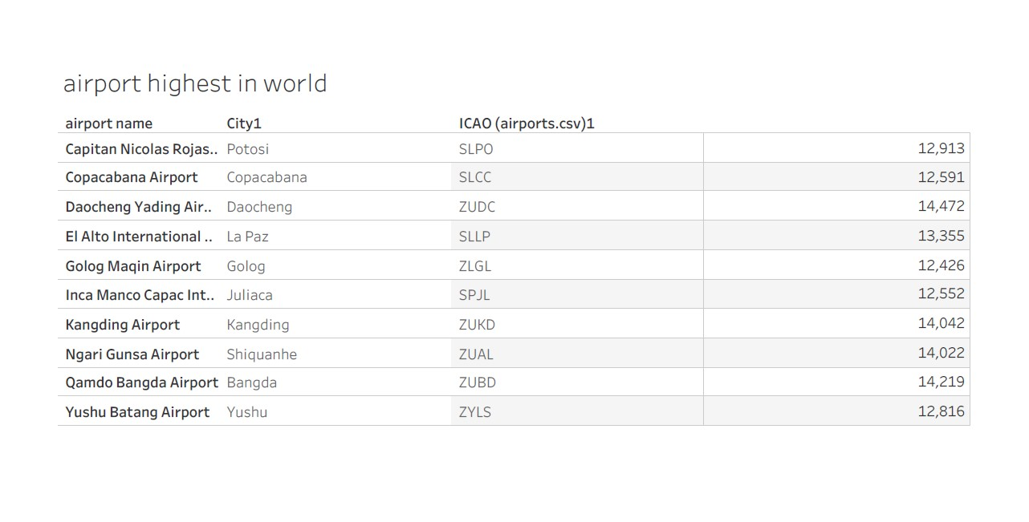

Slide 15
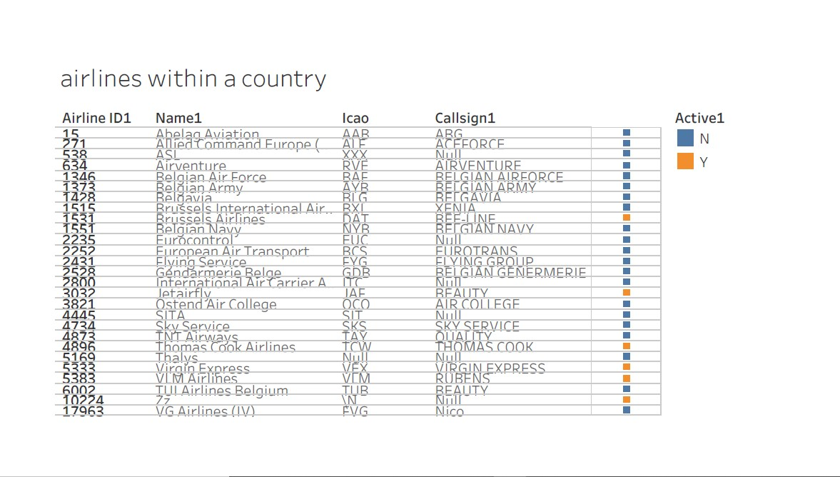

Slide 16
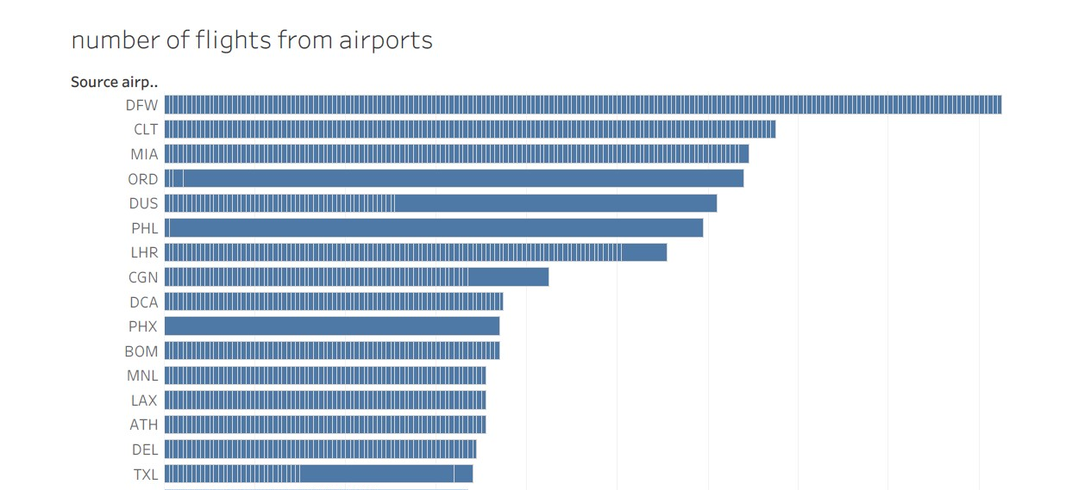

Slide 17
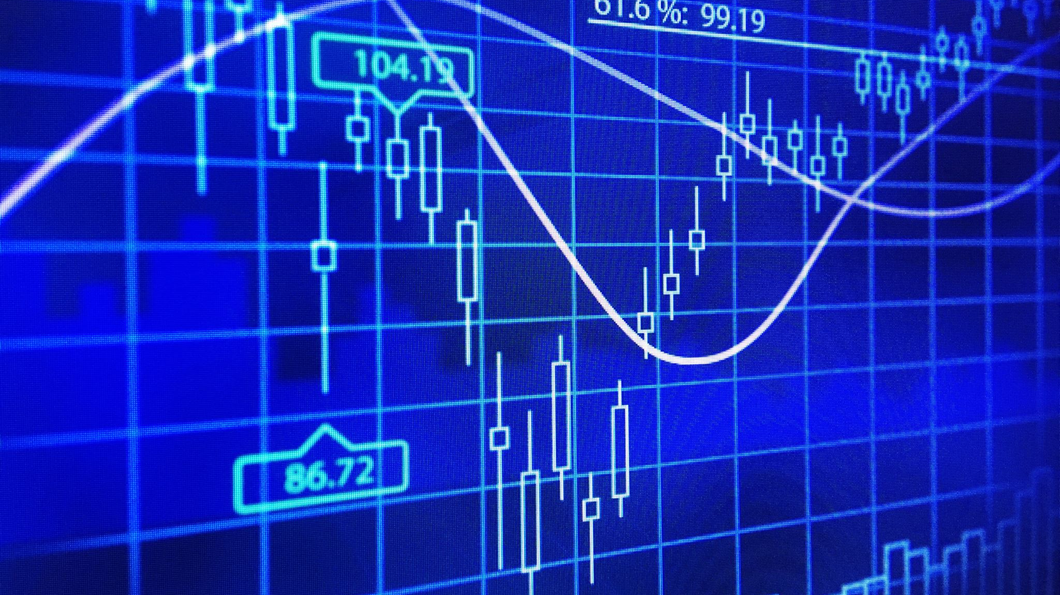
DASHBOARDS

Slide 18
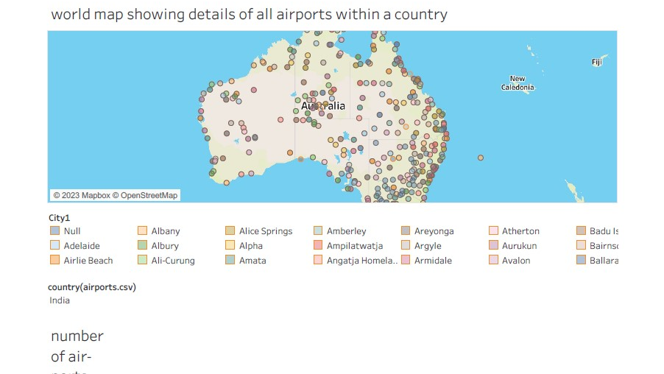

Slide 19
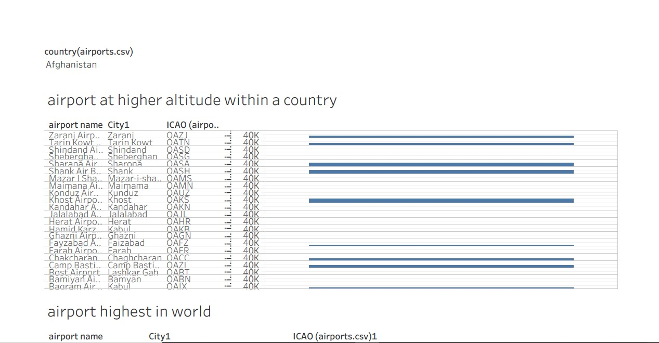

Slide 20
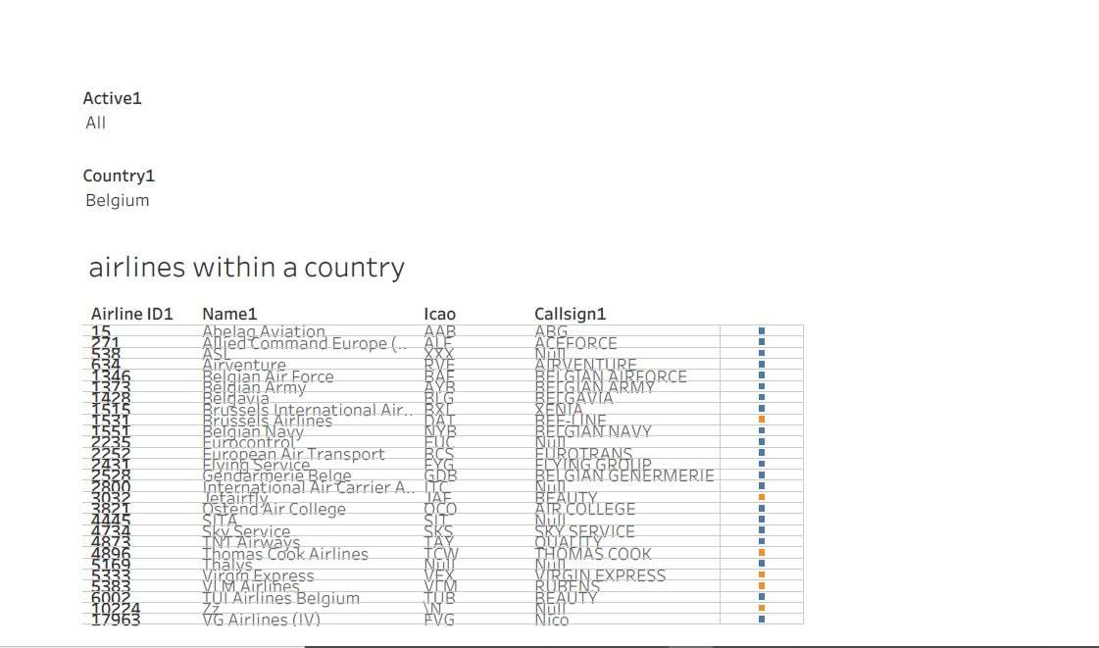

Slide 21

STORY

Slide 22
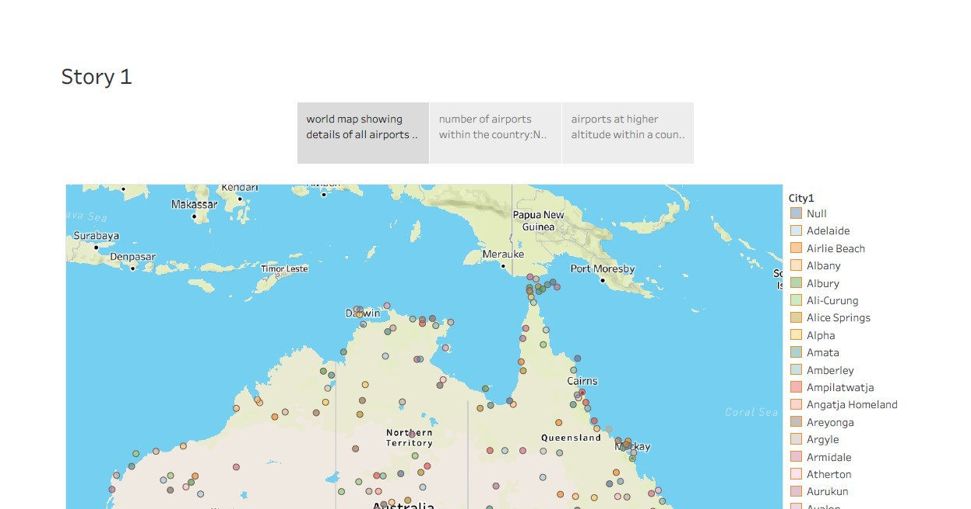

Slide 23
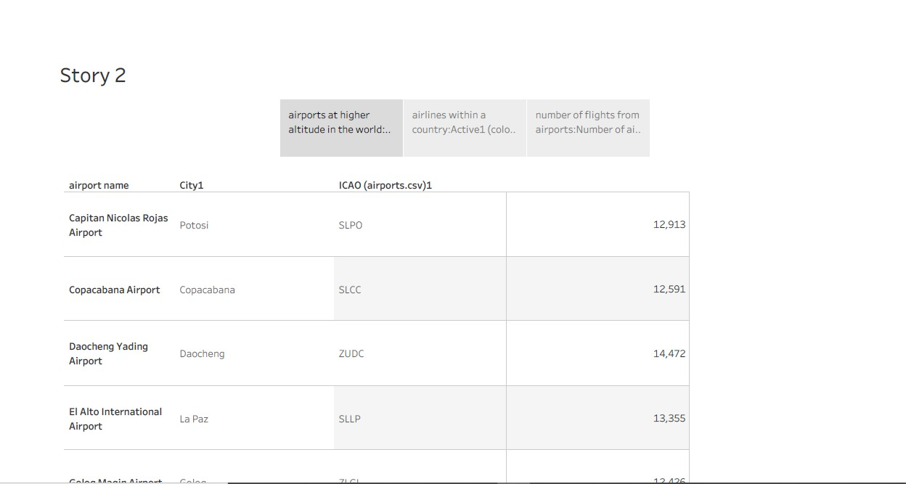

Slide 24
ADVANTAGEES :
DISADVANTAGES :
1. Cost: Tableau licenses and training can be expensive, making it less accessible for smaller organizations or individuals.
2. Learning Curve: Using Tableau effectively requires a learning curve, and not all users may be comfortable with its advanced features.
3. Data Security: Handling sensitive information within Tableau may require additional security measures to protect data from unauthorized access.
4. Performance: Large datasets can impact performance, and organizations might need to invest in powerful hardware to handle big data analytics effectively.
5. Dependency on IT: Complex data models and integrations may require IT support, creating dependencies within organizations.
1. Data Visualization: Tableau provides powerful data visualization tools, making it easier to understand complex data related to the global air transportation network.
2. Interactive Dashboards: Users can create interactive dashboards that allow for real-time exploration of data, enabling better decision-making and trend analysis.
3. Improved Efficiency: Tableau can automate data extraction and transformation, reducing the time and effort required for data analysis.
4. Data Integration: It can integrate data from various sources, helping organizations combine information to gain a holistic view of the air transportation network.
5. Predictive Analysis: Tableau supports predictive modeling and forecasting, enabling organizations to plan for the future.

Slide 25
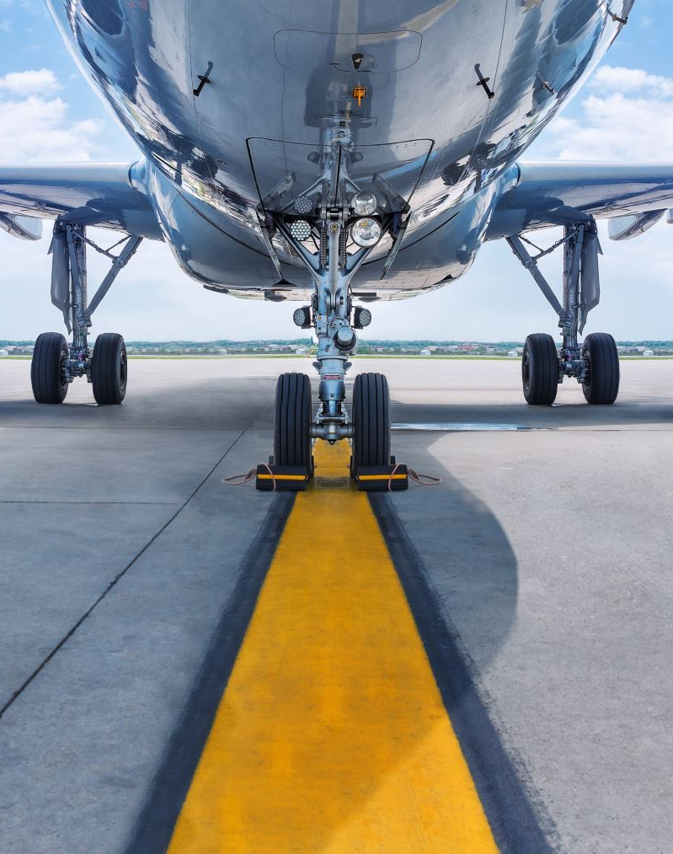
CONCLUSION :
Tableau empowers the aviation industry to optimize operations, enhance customer experiences, and make informed strategic choices. It allows airlines, airports, regulatory bodies, and other entities to harness the power of data visualization and analytics to ensure the efficient and safe functioning of the global air transportation network. By leveraging Tableau's capabilities, the industry can adapt to changing demands, improve sustainability, and ultimately provide a seamless and reliable air travel experience for passengers worldwide

Slide 26

FUTURE SCOPE :
The future of unlocking insights into the global air transportation network with Tableau will involve harnessing the power of data in increasingly sophisticated ways, leading to more efficient and sustainable air travel experiences while addressing the industry's evolving challenges.

Slide 27

THANK YOU

